Slide 1

Frito Lay Employee Attrition Data Analysis
Christopher Haub

Slide 2
Introduction
This is an analysis of employee attrition at Frito Lay. The data set was given to us by the company to find insights and trends relating to employee attrition.
Analysis of statistical significance and correlation of data was performed to better understand employee attrition.

Slide 3
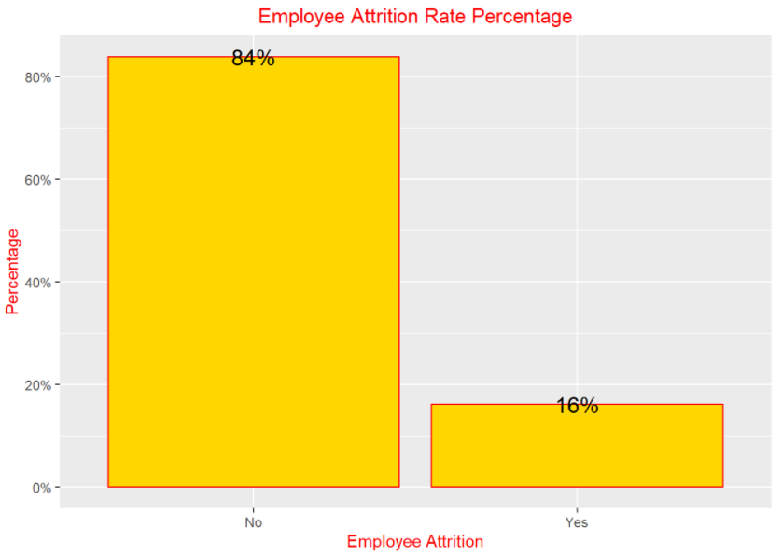
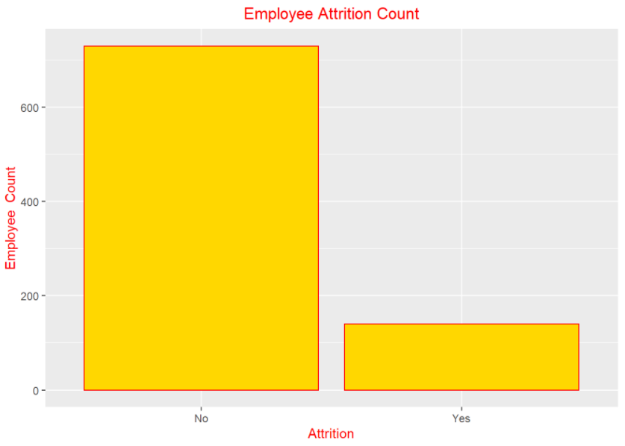
Attrition
There are 870 employees in the data set with an overall attrition rate of 16.09%

Slide 4
Attrition Variables
Next, we will look at how individual variables contribute to attrition.
Age
Education
Job Role
Income
Travel
Time of Service

Slide 5
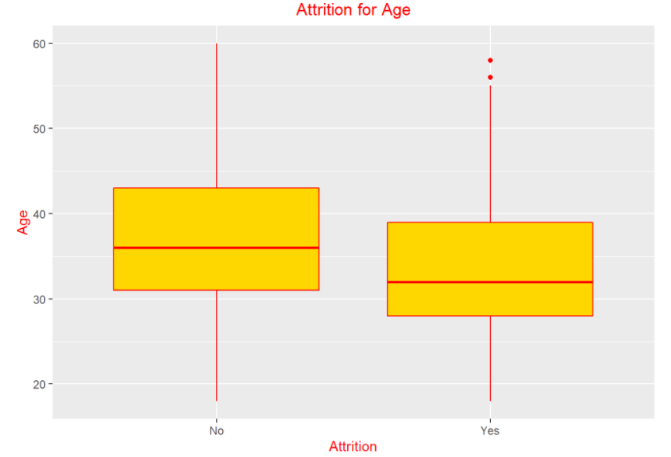
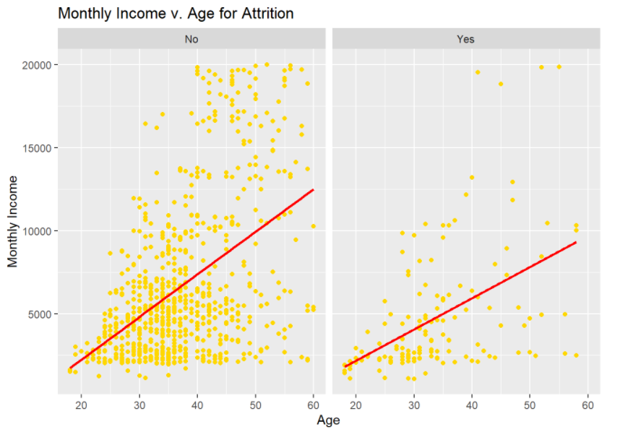
Age Role in Attrition
Median age in data set was 35. Minimum was 18, maximum 60. Age and attrition are correlated. Younger employees are more likely to quit while older employees are more likely to stay. Income and Age are correlated as well. As age increases, income increases.

Slide 6
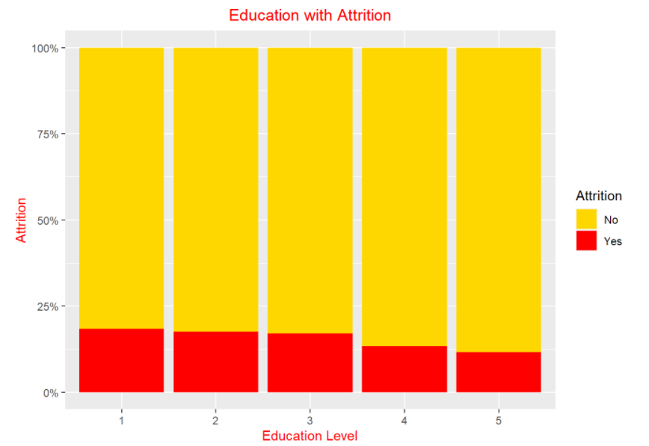
Education in Attrition
Higher education levels have less attrition.
The Human Resources education field has the highest rate of attrition.
Level 1 education, has highest attrition rate.
Level 5 education, has lowest attrition rate.
Level 5, has the highest median monthly income.

Slide 7
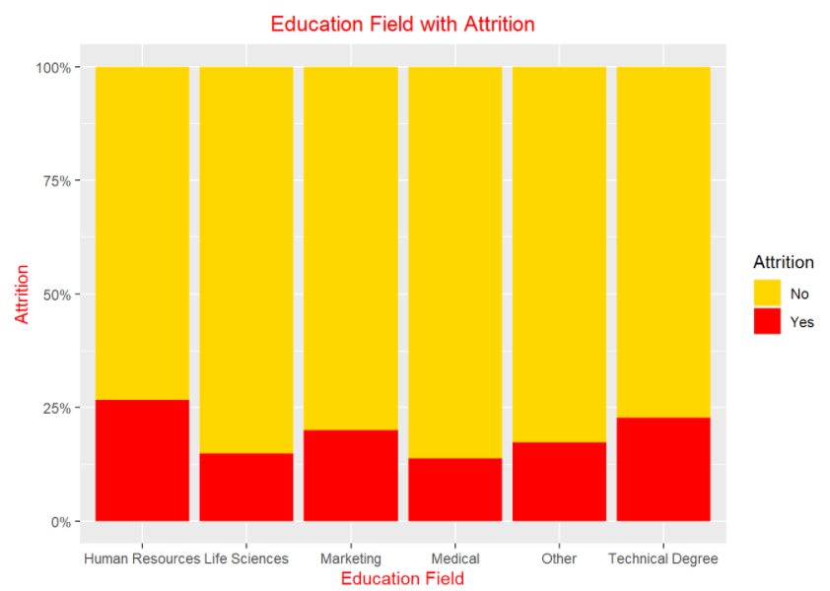
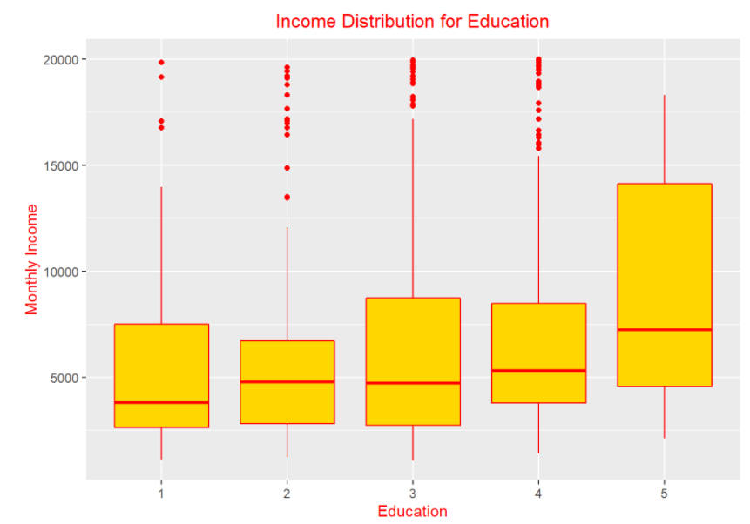
Education

Slide 8
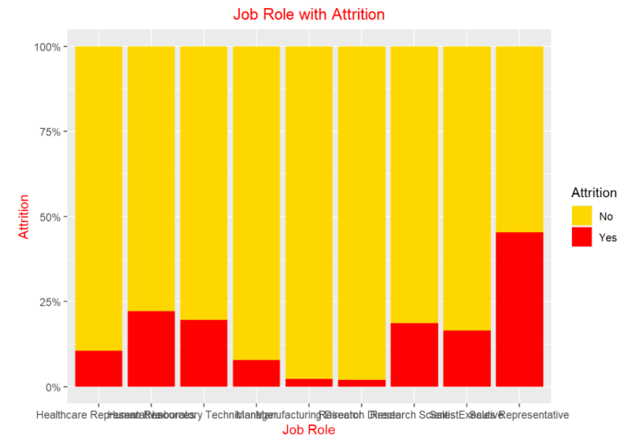
Job Role in Attrition
Sales Representatives have the highest level of attrition.
Managers , then Research Directors have the highest median income.

Slide 9
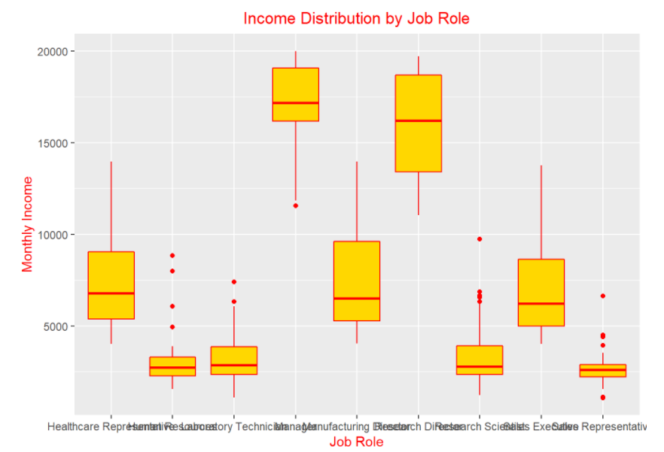
Job Role

Slide 10
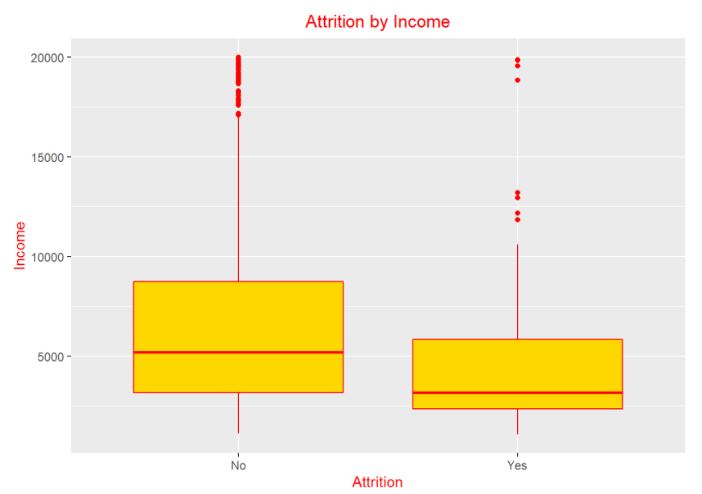
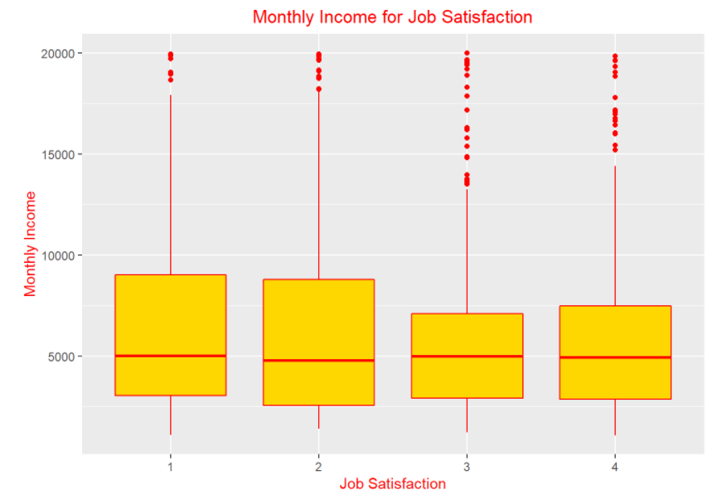
Income in Attrition
Higher monthly income results in less attrition. Employees who make more are less likely to quit.
Higher incomes have higher job satisfaction.
Income and attrition are correlated.

Slide 11
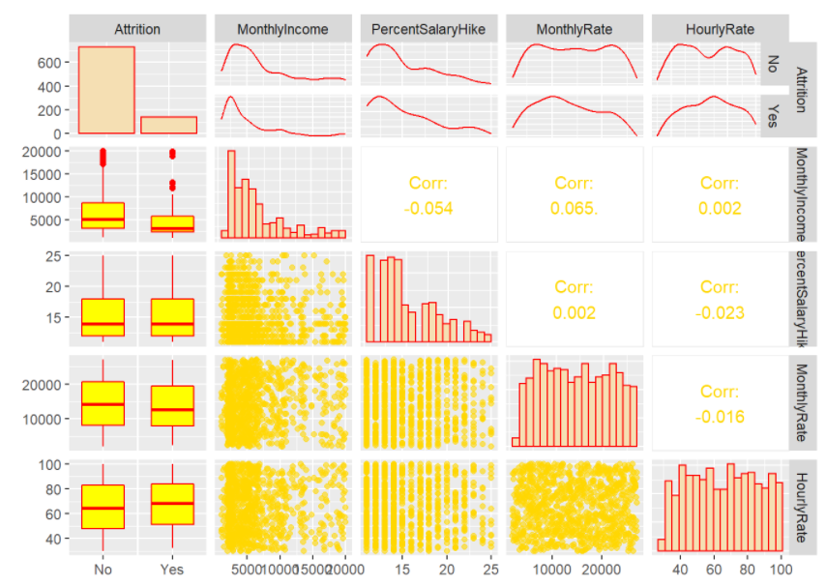
Income Variables Correlation

Slide 12
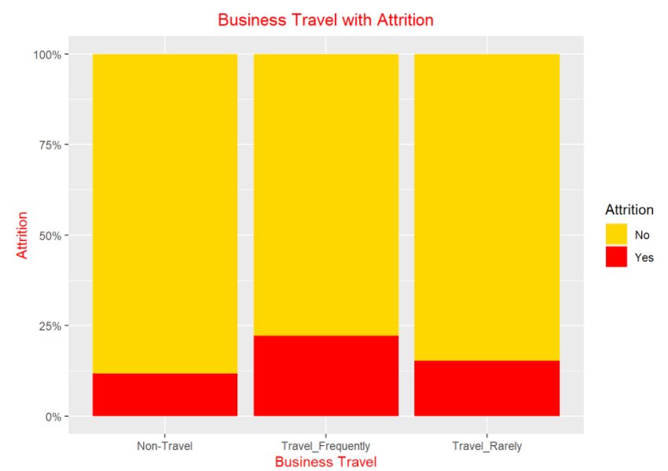
Travel in Attrition
Employees who travel the most, are most likely to quit.

Slide 13
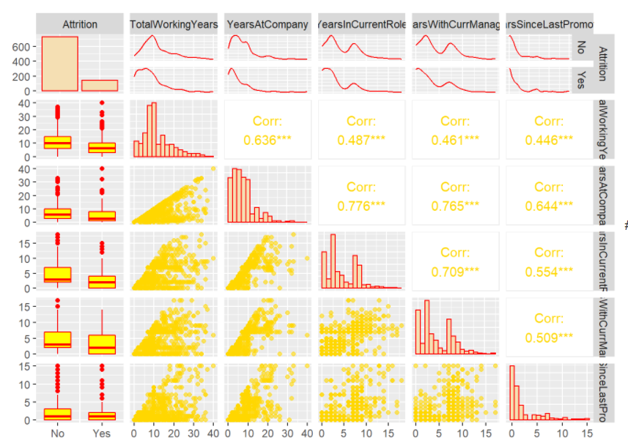
Elapsed Time of Service Correlation Plot

Slide 14
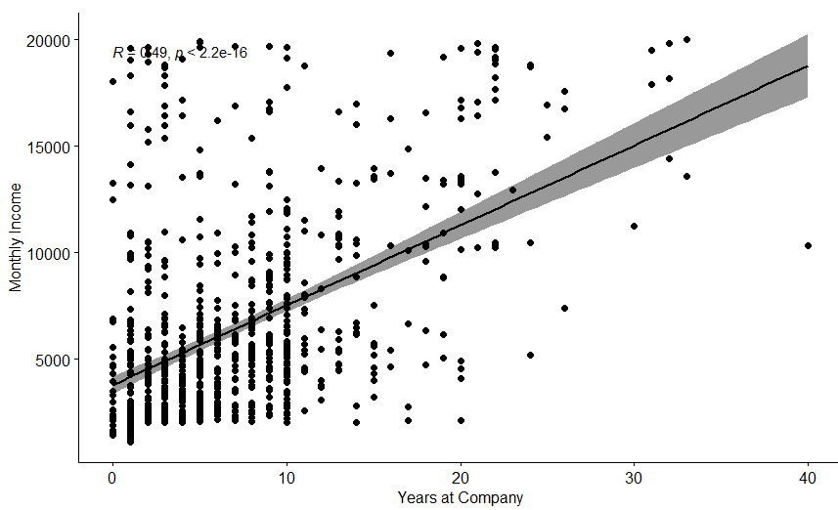
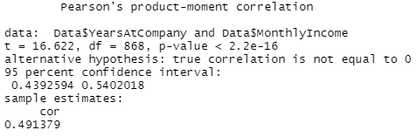
Pearson Correlation Test Years at Company, Monthly Income

Slide 15
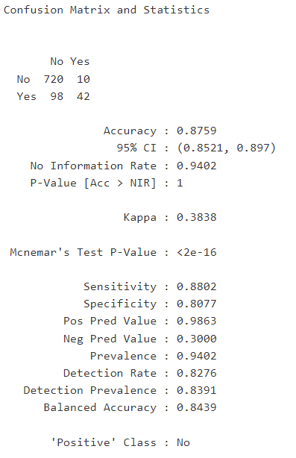
KNN Prediction
Accuracy 88% with 95% Confidence Interval
Sensitivity 88%, correctly predicts no attrition
Specificity 80%, correctly predicts attrition

Slide 16
Top Turnover Factors
Age – The younger an employee is the more likely they are to quit.
Job Role – Sales Representatives have high attrition at almost 50 %, double the next closest role
Income – The less money an employee makes the more likely they are to contribute to attrition

Slide 17
Interesting Observations
Sales Representatives have the highest attrition, however they also have the highest job satisfaction rate.
Income and Age are correlated throughout the data
The most frequent business travelers are most likely to lead to attrition.
Higher Incomes have higher job satisfaction rates.

Slide 18
Recommendations
Sales Representatives – Would be a good idea to meet with them to see challenges they are facing. While we cannot know in data, good chance they are facing several of the headwinds that cause attrition, including travel and pay. They are happy as a group, so pay could be an issue, or possibly leaving for another company where do not have to travel as much.
Pay and age are correlated, research further how raises are being given and can be targeted better to keep younger people from quitting.
Younger workers – Can we promote them, find career tracks to suit them so they do not leave.
Education – Higher education likely to leave, look into investing more into employee education programs and reimbursement for further education.

Slide 19
Thank You!
GitHub https://github.com/chrishaub/CaseStudy2DDS
YouTube https://youtu.be/PwKmUaIO3gA

